Slide 1
Megatron-LM
Bryan Catanzaro, VP Applied Deep Learning Research

Slide 2
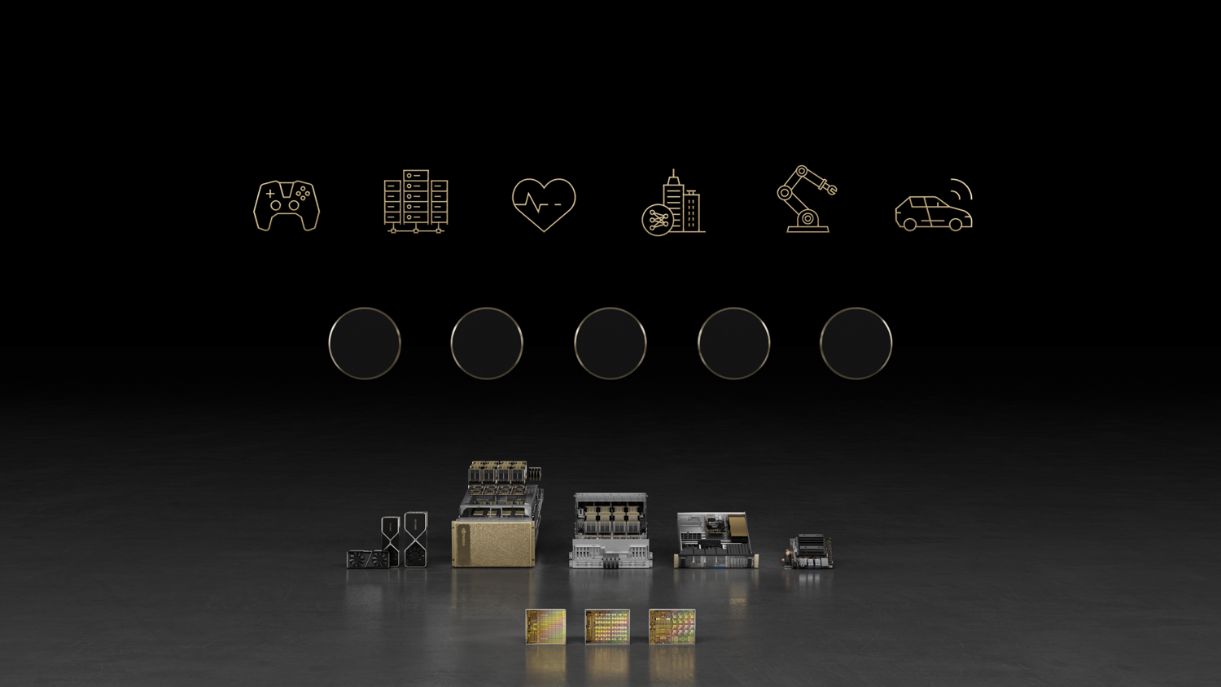

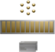



Accelerated computing: do the computationally impossible
Incredible speed-ups take more than just powerful chips
Full-stack invention: chips, systems, frameworks, compilers, algorithms, apps
Entire stack must be co-optimized This is mostly software work

Slide 3
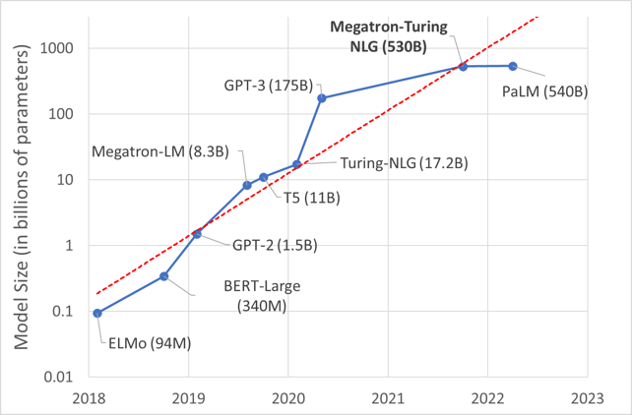
The Soul of Megatron-LM https://github.com/NVIDIA/Megatron-LM
Today’s NLP models require a few million dollars to train so we must have:
Efficiency: we measure it as the percentage of theoretical peak FLOPs of a processor
Best ROI
Up to 56% MFU for Megatron-LM
Scalability: Efficient scaling of both model size (weak scaling) and number of GPUs (strong scaling)
Biggest model & dataset
Simplicity: Simple yet efficient algorithms mostly in Python, with no fancy compiler
Model innovation & agility

Slide 4
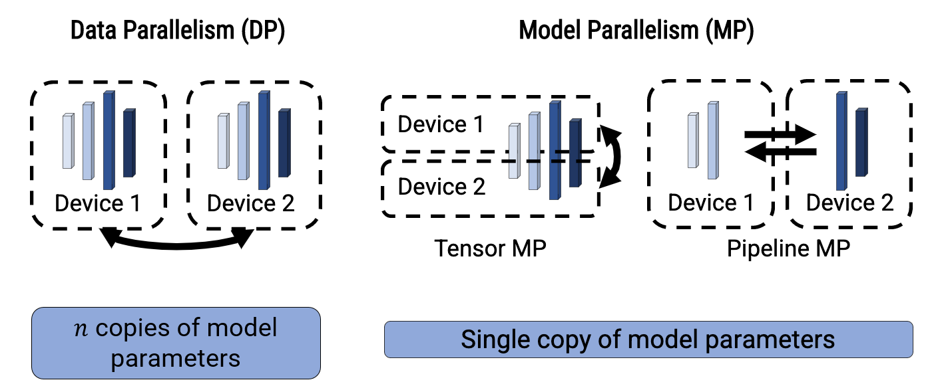
Data and Model Parallelism

Slide 5
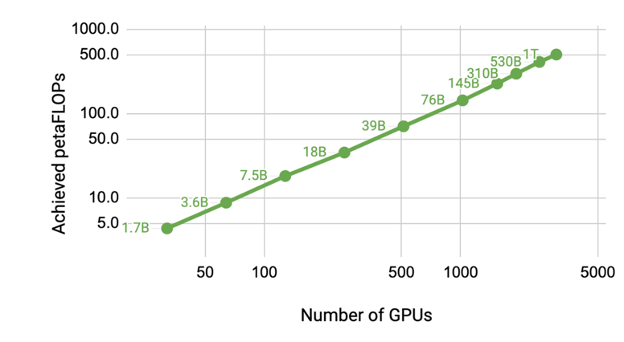
Efficiency and Scalability
Achieve scalability using data and model parallelism
Model parallelism:
Tensor parallelism
Sequence parallelism
Pipeline parallelism
Challenge: how to achieve efficiency at scale
Measured Megatron-LM Scaling
Almost linear scaling for models from 1B to 1T parameters (3 orders of magnitude) across 32 to 3K GPUs (2 orders of magnitude)

Slide 6

Simplicity
The Megatron-LM project is built in PyTorch
I love compilers! I think the world needs awesome compilers for AI
But we have an urgent mission:
Accelerate Transformers
Automatic parallel compilers for AI are hard
We are doing this all by hand
This shows us Speed-of-light
Space is moving quickly
New ideas all the time

Slide 7

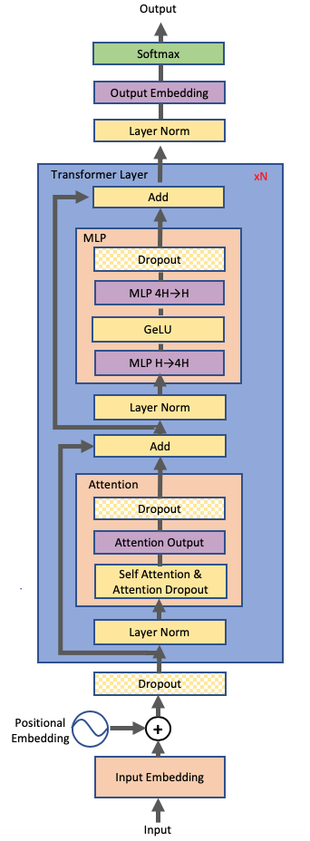
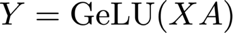
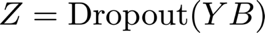

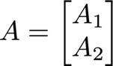
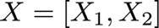
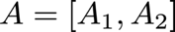
Model Parallel MLP
MLP:
Approach 1: split X column-wise and A row-wise:
Before GeLU, we will need a synchronization point
Approach 2: split A column-wise:
no synchronization is required

Slide 8
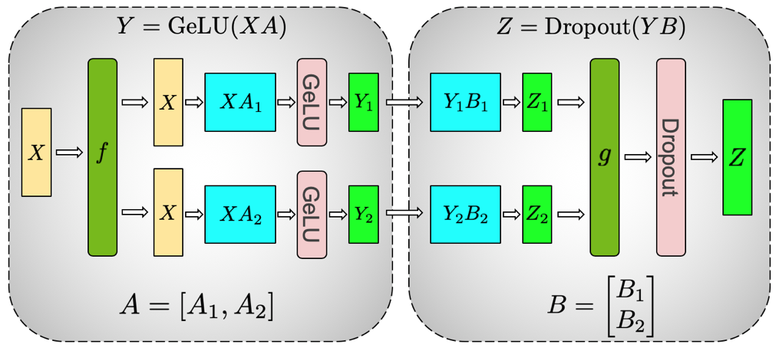
A column-wise, B row-wise: ½ the communication
f and g are conjugate, f is identity operator in the forward pass and all-reduce in the backward pass while g is all-reduce in forward and identity in backward.

Slide 9
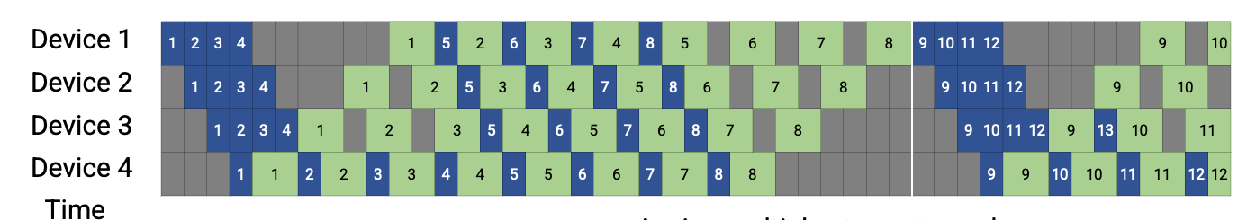
Pipeline Parallelism
Divides a batch size into micro-batches to keep the pipeline pressurized
However, due to synchronous gradient updates, we have idle times (bubble) at the beginning and end of each iteration
Synchronous Gradient update
bubble

Slide 10
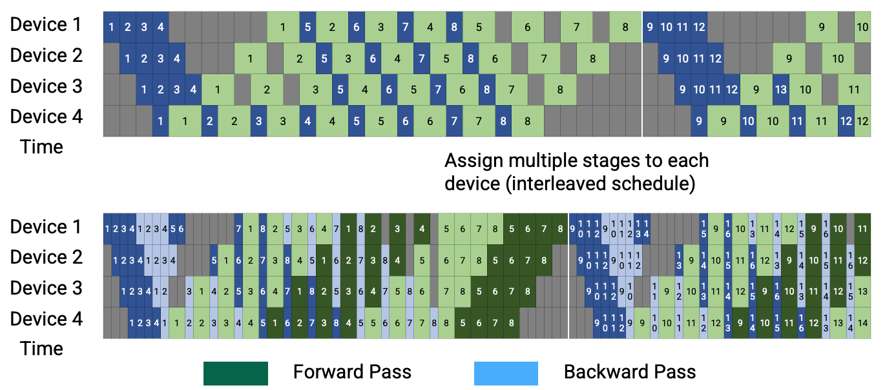
Interleaving Pipeline Schedule

Slide 11
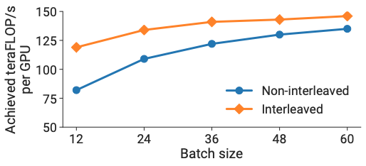
Interleaving Schedule Results
Interleaving more effective at small batch sizes
Good for strong scaling
175B GPT-3 model on 96 GPUs (no data parallelism)

Slide 12
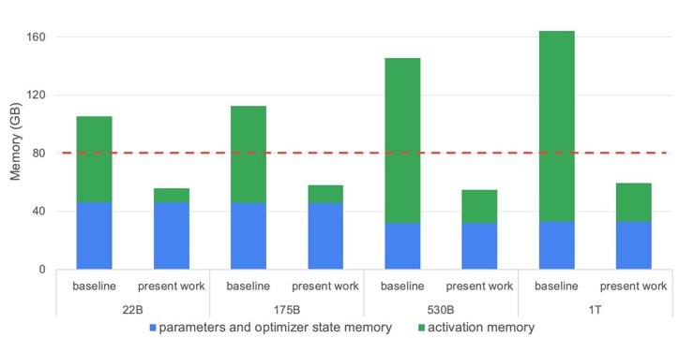
Sequence Parallelism
Activations require a substantial amount of memory for large models.
Tensor parallelism can only reduce parts of activations memory (dropout and layernorms are duplicated)
Standard full activation recomputation introduces 30-40% computational overhead
Red line shows A100/H100 memory
Required memory for tensor + pipeline parallelism

Slide 13
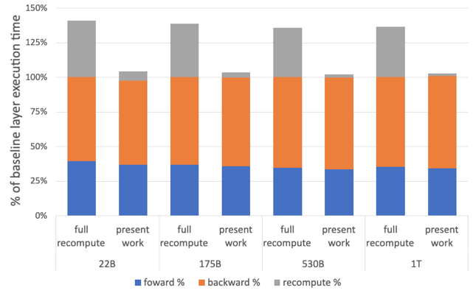
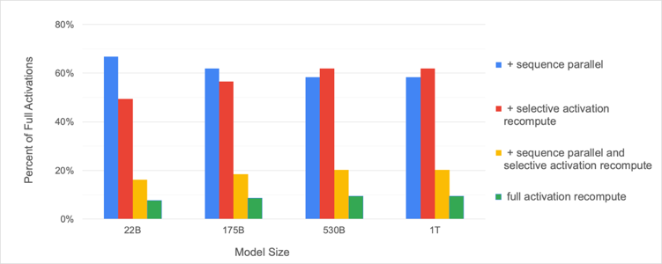
Solution
Sequence parallelism + Selective activation recomputation
56.3% MFU for 1T parameter model on 512 A100 GPUs
Percentage of required activation memory compared to the tensor+pipeline parallel baseline.
Per-layer breakdown; baseline is the case with no activation recomputation or sequence parallelism
Notes:
orthogonal

Slide 14
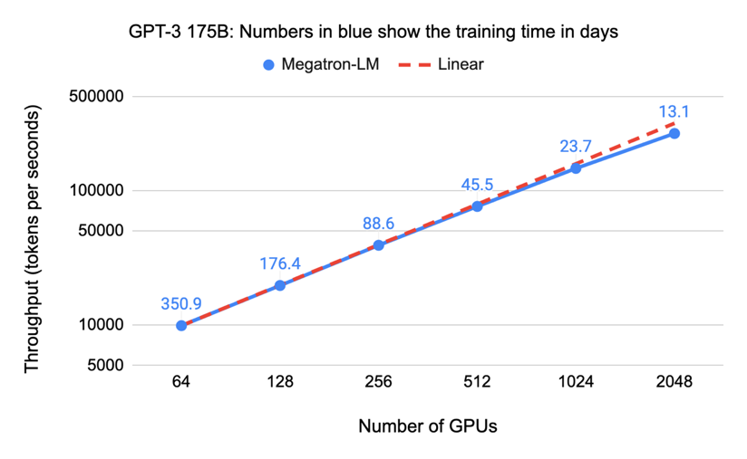
End-to-end Results: Measured Strong Scaling
More work to do here And Beyond
(A100)
32x increase in number of GPUs for fixed model size and batch size

Slide 15
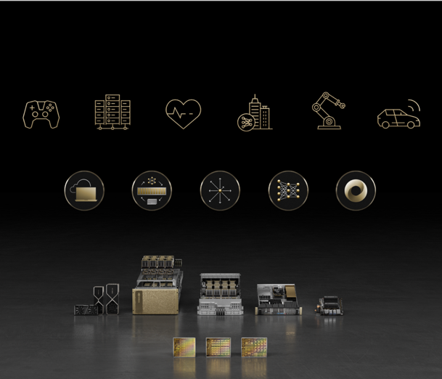
Conclusion
Language models are the biggest compute challenge of our time
Megatron-LM is a research project for big transformers
Megatron technologies productized as part of NVIDIA NeMo
Current work focuses on multimodality and more complex training setups
A golden age for AI systems: so much more than chips
@ctnzr

